Slide 1
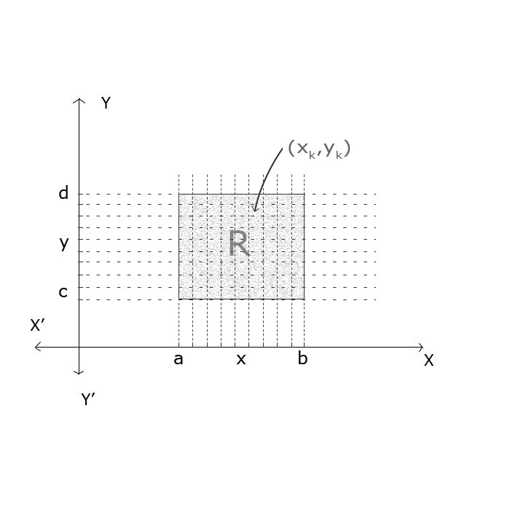
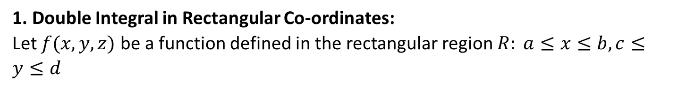
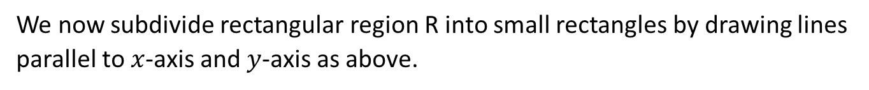
Multiple Integrals
1. Double Integral in Rectangular Co-ordinates:
Let $f(x,y,z)$ be a function defined in the rectangular region $R: a≤x≤b, c≤y≤d$
We now subdivide rectangular region R into small rectangles by drawing lines parallel to $x$-axis and $y$-axis as above.

Slide 2
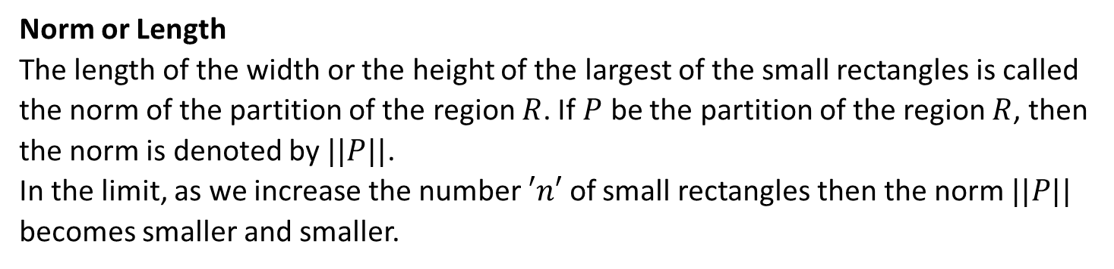
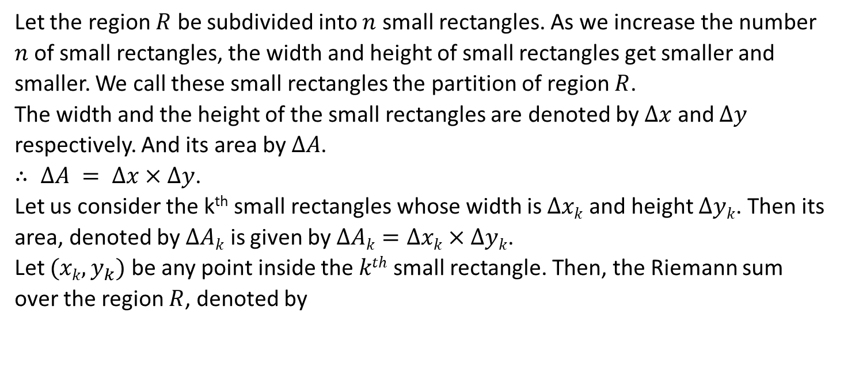
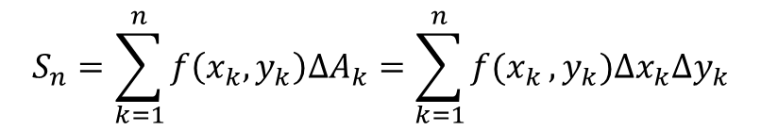
Let the region $R$ be subdivided into $n$ small rectangles. As we increase the number $n$ of small rectangles, the width and height of small rectangles get smaller and smaller. We call these small rectangles the partition of region $R$.
The width and the height of the small rectangles are denoted by $Δx$ and $Δy$ respectively. And its area by $ΔA$.
$∴ ΔA = Δx×Δy$.
Let us consider the k^{th} small rectangles whose width is $Δxk$ and height $Δyk$. Then its area, denoted by $ΔAk$ is given by $ΔAk=Δxk×Δyk$­.
Let $(xk,y_{k})$ be any point inside the $kth$ small rectangle. Then, the Riemann sum over the region $R$, denoted by
$$S_{n}=\sum_{k=1}^{n}{f\left(x_{k},y_{k}\right)∆A_{k}=\sum_{k=1}^{n}{f(x_{k}},y_{k})∆x_{k}∆y_{k}}$$
Norm or Length
The length of the width or the height of the largest of the small rectangles is called the norm of the partition of the region $R$. If $P$ be the partition of the region $R$, then the norm is denoted by $||P||$.
In the limit, as we increase the number $′n′$ of small rectangles then the norm $||P||$ becomes smaller and smaller.

Slide 3
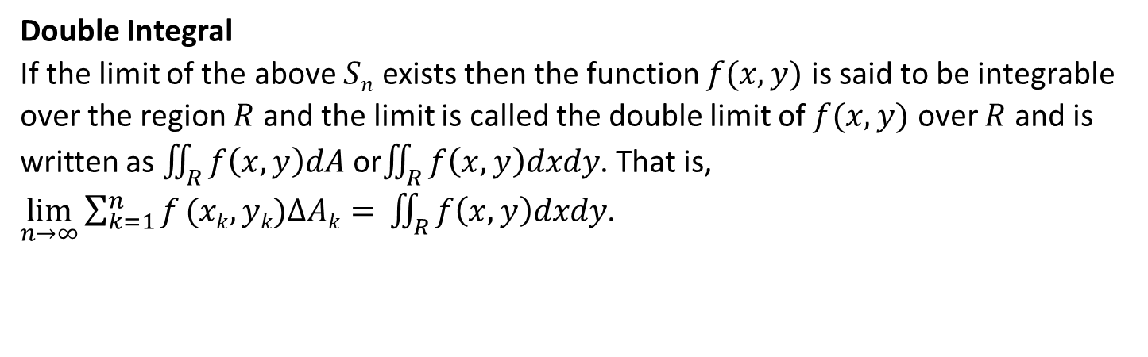
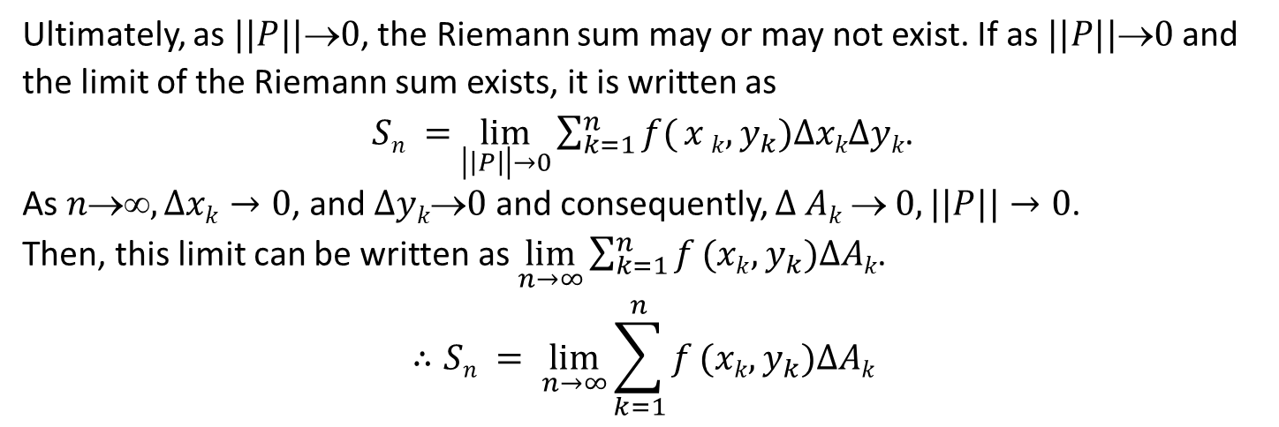
Ultimately, as $||P||0$, the Riemann sum may or may not exist. If as $||P||0$and the limit of the Riemann sum exists, it is written as
$Sn =$ $\lim_{\left|\left|P\right|\right|→0}{\sum_{k=1}^{n}{f(}x}k,y_{k})ΔxkΔyk$.
As $n, Δxk→0$, and $Δyk0$ and consequently, $Δ Ak  0, ||P||→0$.
Then, this limit can be written as $\lim_{n→∞}{\sum_{k=1}^{n}{f}}(xk,y_{k})ΔAk$.
$$∴Sn = \lim_{n→∞}{\sum_{k=1}^{n}{f}}(xk,y_{k})ΔAk$$
Double Integral
If the limit of the above $Sn$ exists then the function $f(x,y)$ is said to be integrable over the region $R$ and the limit is called the double limit of $f(x,y)$ over $R$ and is written as $\iint_{R}{f\left(x,y\right)dA}$ or$\iint_{R}{f\left(x,y\right)dxdy}$. That is,
$\lim_{n→∞}{\sum_{k=1}^{n}{f}}(xk,yk)ΔAk=$ $\iint_{R}{f\left(x,y\right)dxdy}$.

Slide 4
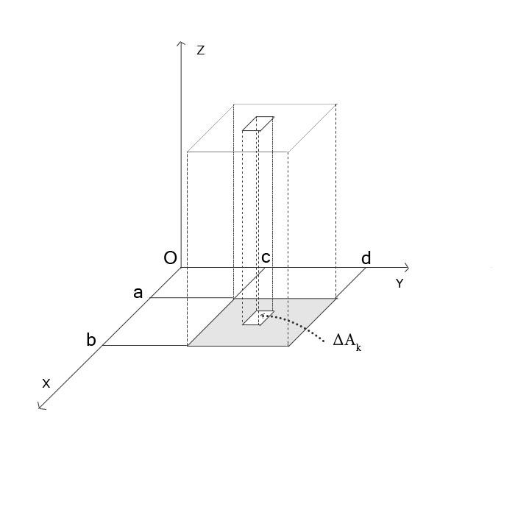
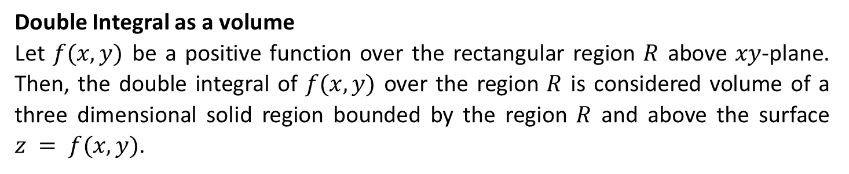
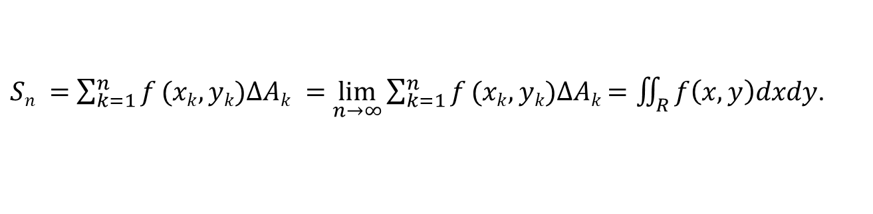
Double Integral as a volume
Let $f(x,y)$ be a positive function over the rectangular region $R$ above $xy$-plane. Then, the double integral of $f(x,y)$ over the region $R$ is considered volume of a three dimensional solid region bounded by the region $R$ and above the surface $z = f(x,y)$.
$Sn =$ $\sum_{k=1}^{n}{f}(xk,yk)ΔAk =$ $\lim_{n→∞}{\sum_{k=1}^{n}{f}}(xk,yk)ΔAk$ $=\iint_{R}{f\left(x,y\right)dxdy}$.

Slide 5
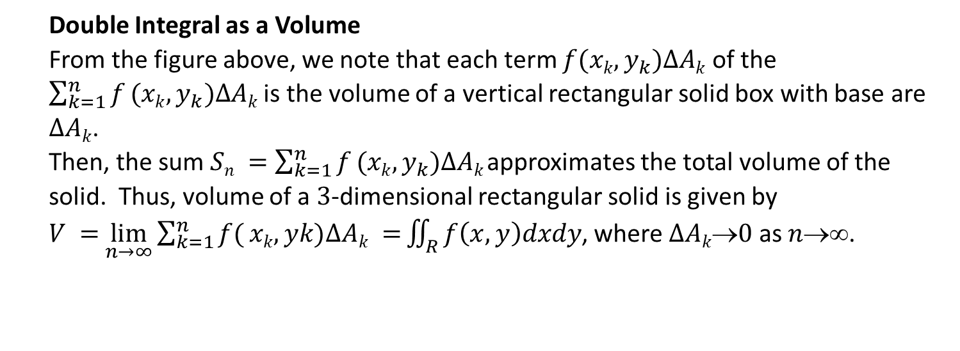
Double Integral as a Volume
From the figure above, we note that each term $f(xk,y_{k})ΔAk$ of the $\sum_{k=1}^{n}{f}(xk,y_{k})ΔAk$ is the volume of a vertical rectangular solid box with base are $ΔAk$.
Then, the sum $Sn =$ $\sum_{k=1}^{n}{f}(xk,y_{k})ΔAk$ approximates the total volume of the solid. Thus, volume of a $3$-dimensional rectangular solid is given by
$V =$ $\lim_{n→∞}{\sum_{k=1}^{n}{f(}}xk,yk)ΔAk =$ $\iint_{R}{f\left(x,y\right)dxdy}$, where $ΔAk0$ as $n$.

Slide 6
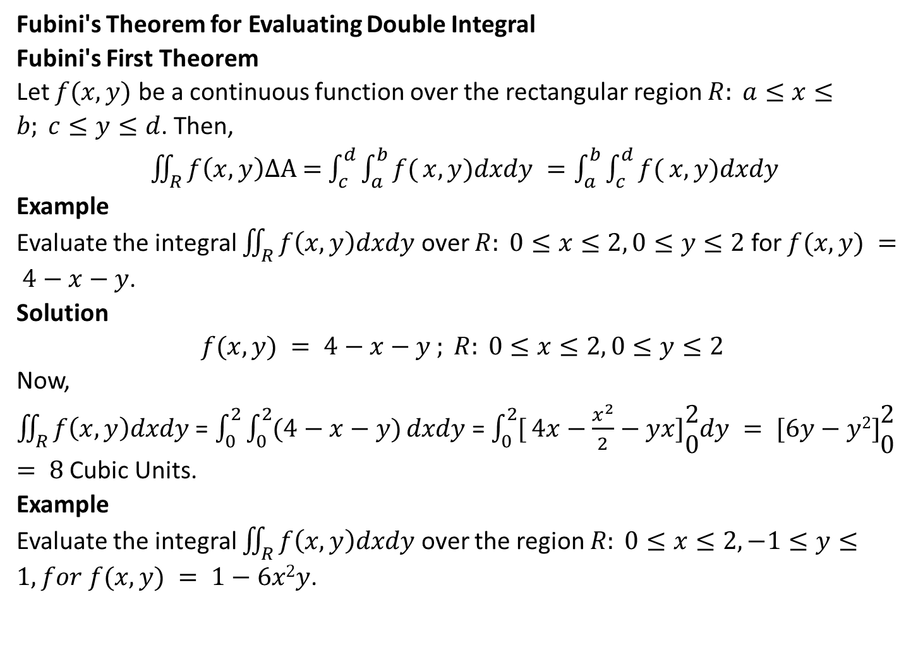
Fubini's Theorem for Evaluating Double Integral
Fubini's First Theorem
Let $f(x,y)$ be a continuous function over the rectangular region $R: a≤x≤b; c≤y≤d$. Then,
$\iint_{R}{f\left(x,y\right)ΔA}$ $=$ $\int_{c}^{d}{\int_{a}^{b}{f(}}x,y)dxdy =\int_{a}^{b}{\int_{c}^{d}{f(}}x,y)dxdy$
Example
Evaluate the integral $\iint_{R}{f\left(x,y\right)dxdy}$ over $R: 0≤x≤2, 0≤y≤2$ for $f(x,y) = 4−x−y$.
Solution
$$f(x,y) = 4−x−y ; R: 0≤x≤2, 0≤y≤2$$
Now,
$\iint_{R}{f\left(x,y\right)dxdy}$ = $\int_{0}^{2}{\int_{0}^{2}{(4−x−y)}}dxdy$ = $\int_{0}^{2}{[}4x−\frac{x^{2}}{2}−yx]\begin{matrix}2 \\ 0\end{matrix}dy = [6y−y2]\begin{matrix}2 \\ 0\end{matrix}$ $= 8$ Cubic Units.
Example
Evaluate the integral $\iint_{R}{f\left(x,y\right)dxdy}$ over the region $R: 0≤x≤2, −1≤y≤1, for f(x,y) = 1−6x2y$.

Slide 7
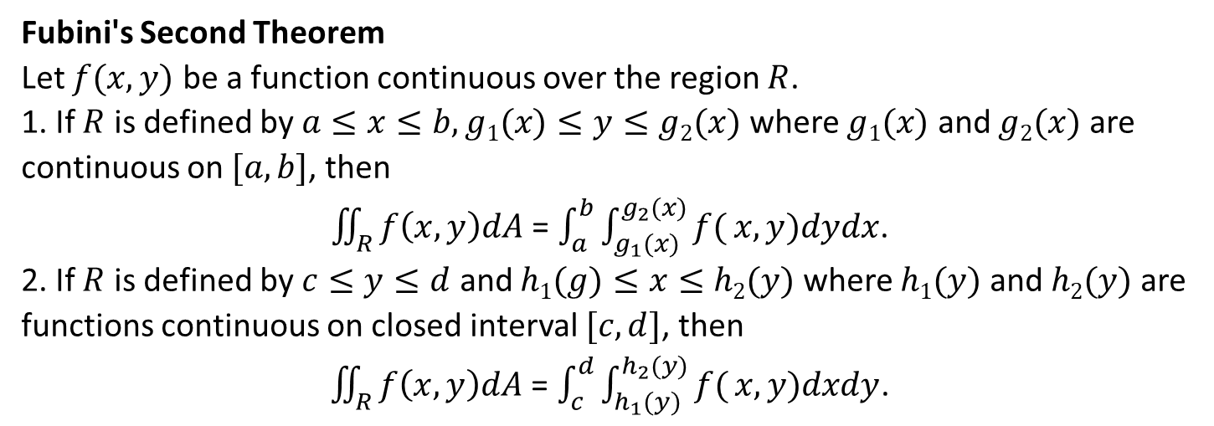
Fubini's Second Theorem
Let $f(x,y)$ be a function continuous over the region $R$.
1. If $R$ is defined by $a≤x≤b, g1(x)≤y≤g2(x)$ where $g1(x)$ and $g2(x)$ are continuous on $[a,b]$, then
$\iint_{R}{f\left(x,y\right)dA}$ = $\int_{a}^{b}{\int_{g_{1}(x)}^{g_{2}(x)}{f(}}x,y)dydx$.
2. If $R$ is defined by $c≤y≤d$ and $h1(g)≤x≤h2(y)$ where $h1(y)$ and $h2(y)$ are functions continuous on closed interval $[c,d]$, then
$\iint_{R}{f\left(x,y\right)dA}$ = $\int_{c}^{d}{\int_{h_{1}(y)}^{h_{2}(y)}{f(}}x,y)dxdy$.

Slide 8
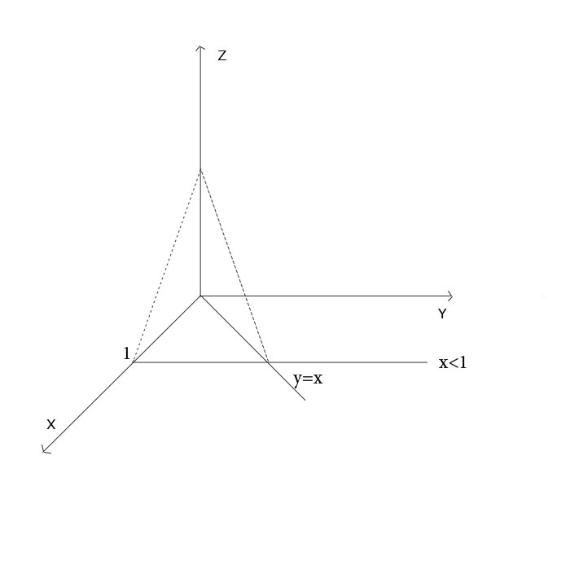
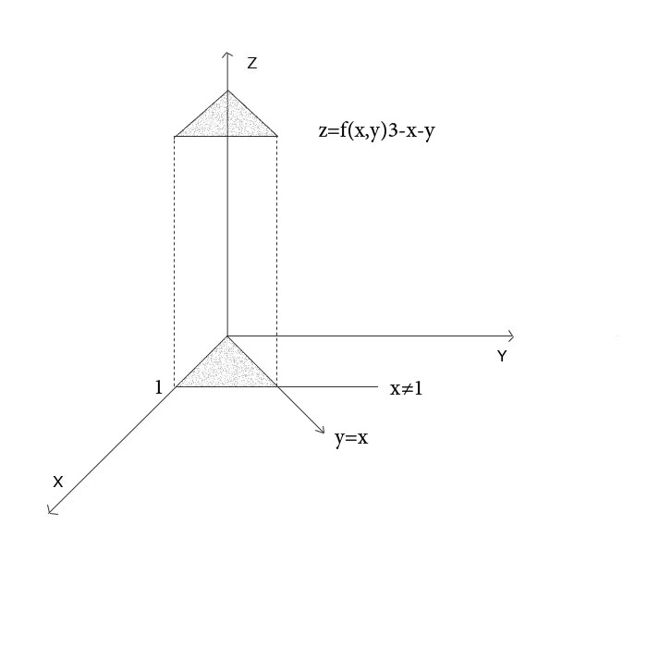
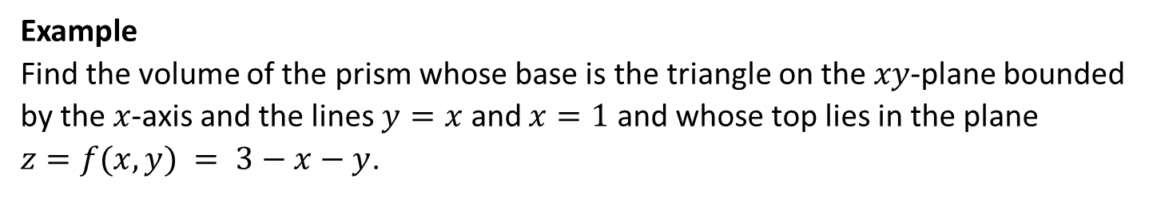
Example
Find the volume of the prism whose base is the triangle on the $xy$-plane bounded by the $x$-axis and the lines $y=x$ and $x=1$ and whose top lies in the plane $z=f(x,y) = 3−x−y$.

Slide 9
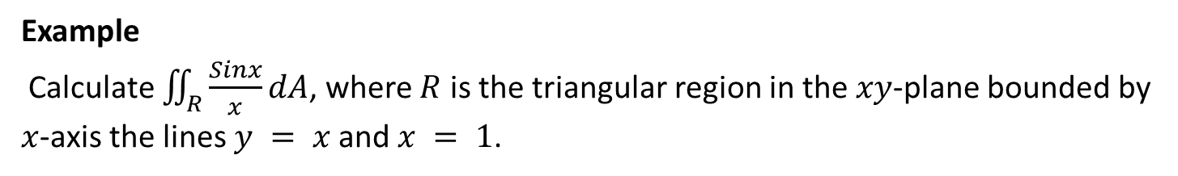
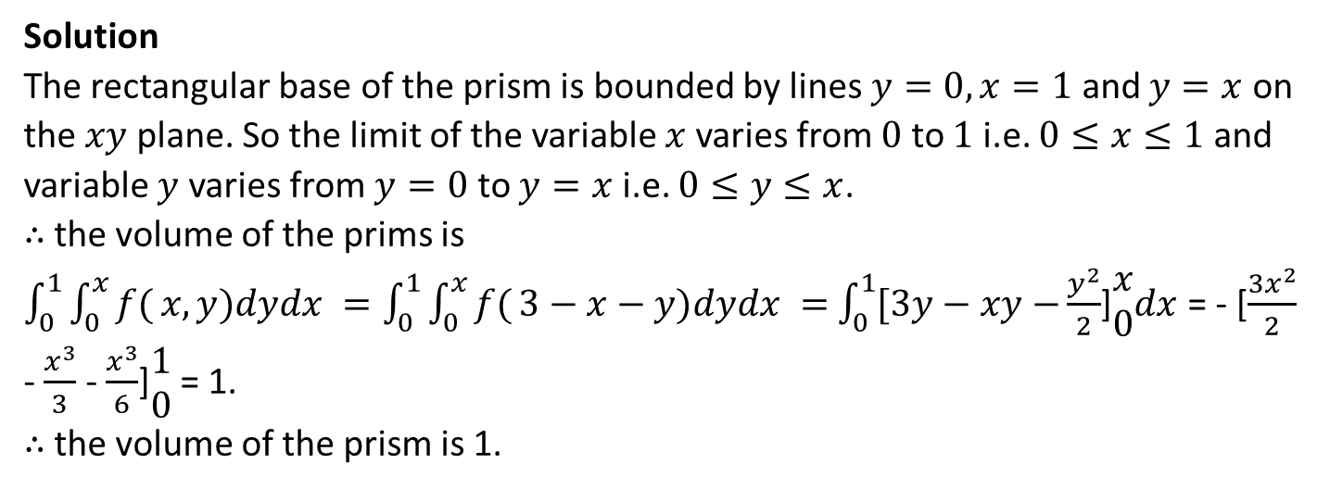
Solution
The rectangular base of the prism is bounded by lines $y=0, x=1$ and $y=x$ on the $xy$ plane. So the limit of the variable $x$ varies from $0$ to $1$ i.e. $0≤x≤1$ and variable $y$ varies from $y=0$ to $y=x$ i.e. $0≤y≤x$.
∴ the volume of the prims is
$\int_{0}^{1}{\int_{0}^{x}{f(}}x,y)dydx =\int_{0}^{1}{\int_{0}^{x}{f(}}3−x−y)dydx =$ $\int_{0}^{1}{[3y−xy−}\frac{y^{2}}{2}$]$\begin{matrix}x \\ 0\end{matrix}dx$ = - [$\frac{3x^{2}}{2}$ - $\frac{x^{3}}{3}$ - $\frac{x^{3}}{6}$]$\begin{matrix}1 \\ 0\end{matrix}$ = 1.
∴ the volume of the prism is 1.
Example
Calculate $\iint_{R}{\frac{Sinx}{x}dA}$, where $R$ is the triangular region in the $xy$-plane bounded by $x$-axis the lines $y = x$and $x = 1$.

Slide 10
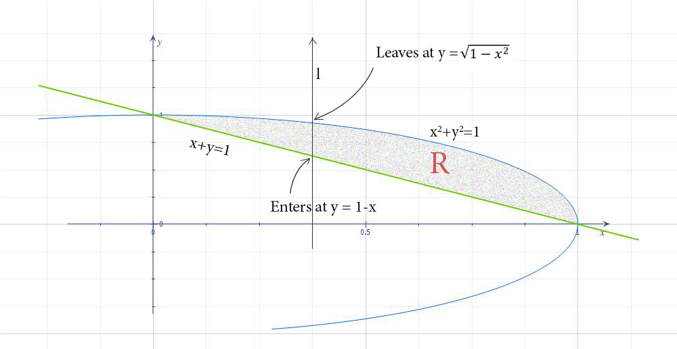
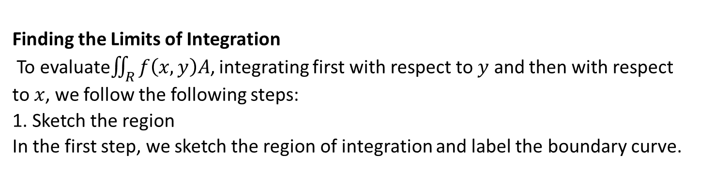
Finding the Limits of Integration
To evaluate$\iint_{R}{f\left(x,y\right)A}$, integrating first with respect to $y$ and then with respect to $x$, we follow the following steps:
1. Sketch the region
In the first step, we sketch the region of integration and label the boundary curve.

Slide 11
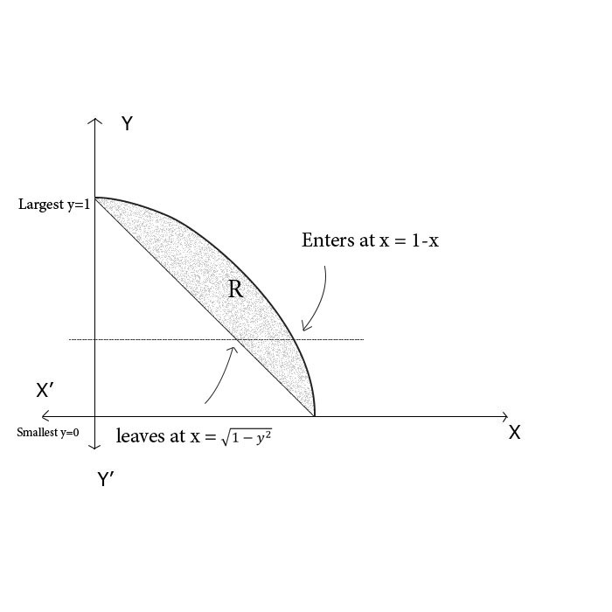
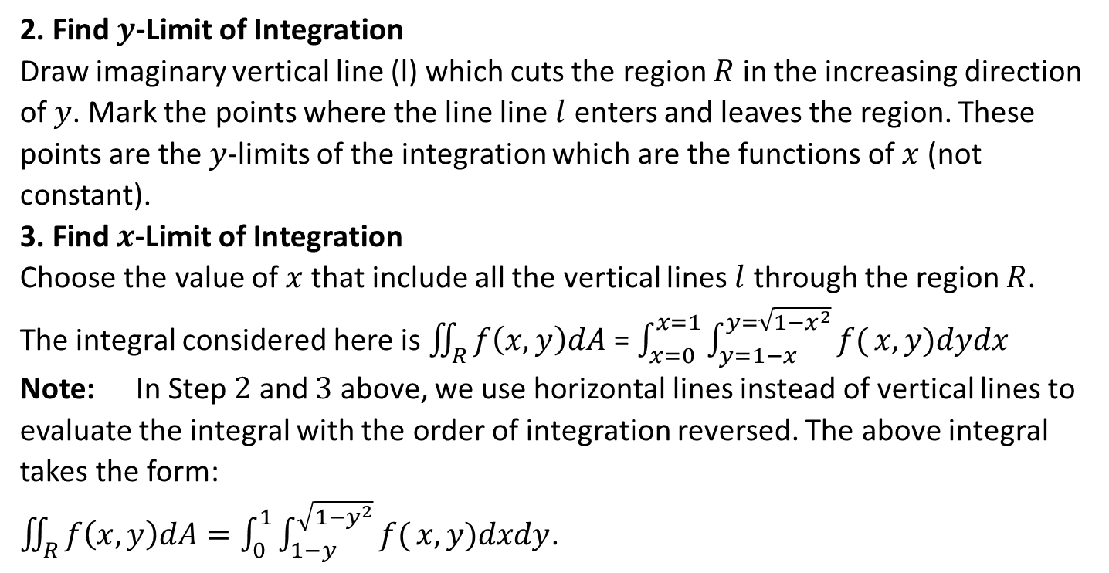
2. Find $y$-Limit of Integration
Draw imaginary vertical line (l) which cuts the region $R$ in the increasing direction of $y$. Mark the points where the line line $l$ enters and leaves the region. These points are the $y$-limits of the integration which are the functions of $x$ (not constant).
3. Find $x$-Limit of Integration
Choose the value of $x$ that include all the vertical lines $l$ through the region $R$.
The integral considered here is $\iint_{R}{f\left(x,y\right)dA}$ = $\int_{x=0}^{x=1}{\int_{y=1−x}^{y=\sqrt{1−x^{2}}}{f(}}x,y)dydx$
Note: In Step $2$ and $3$ above, we use horizontal lines instead of vertical lines to evaluate the integral with the order of integration reversed. The above integral takes the form:
$\iint_{R}{f\left(x,y\right)dA}=\int_{0}^{1}{\int_{1−y}^{\sqrt{1−y^{2}}}{f(}}x,y)dxdy$.

Slide 12
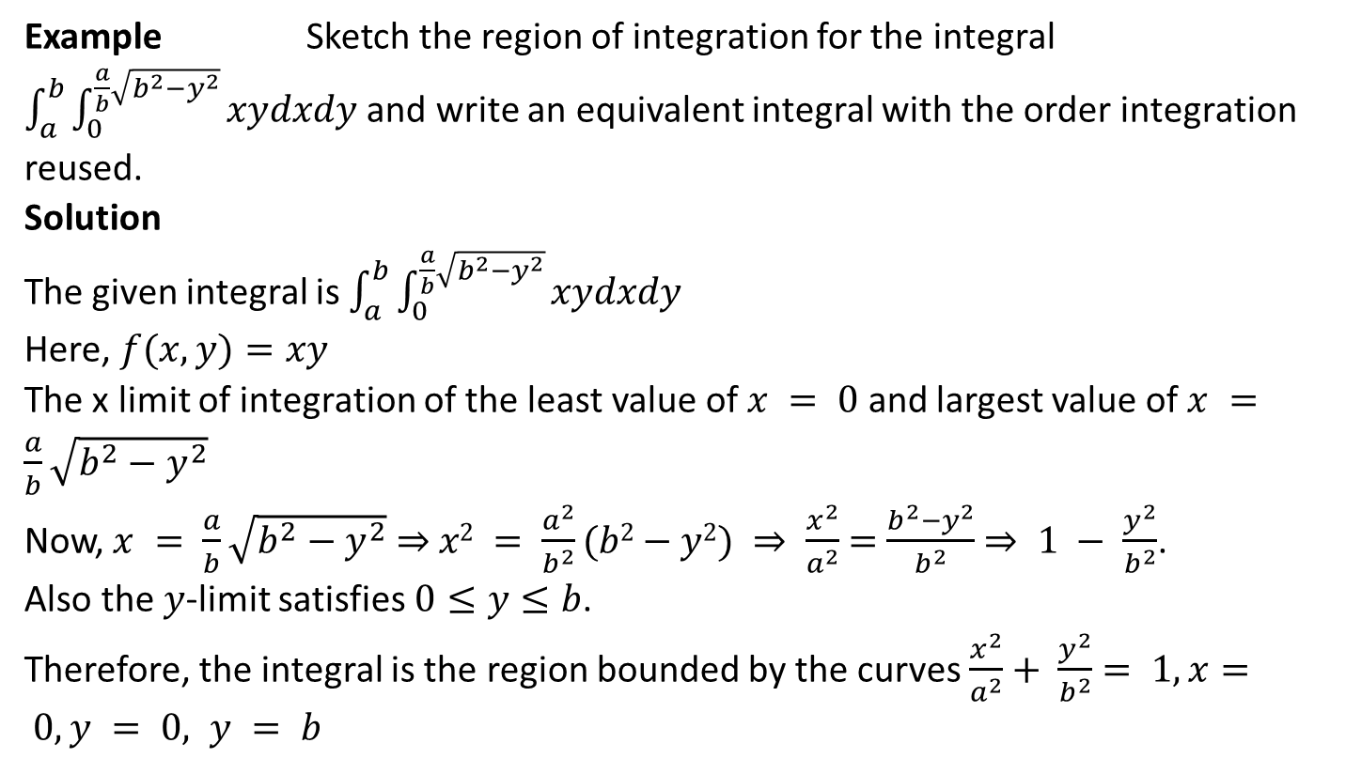
Example Sketch the region of integration for the integral $\int_{a}^{b}{\int_{0}^{\frac{a}{b}\sqrt{b^{2}−y^{2}}}{xydxdy}}$ and write an equivalent integral with the order integration reused.
Solution
The given integral is $\int_{a}^{b}{\int_{0}^{\frac{a}{b}\sqrt{b^{2}−y^{2}}}{xydxdy}}$
Here, $f(x,y)=xy$
The x limit of integration of the least value of $x = 0$ and largest value of $x =$ $\frac{a}{b}\sqrt{b^{2}−y^{2}}$
Now, $x = \frac{a}{b}\sqrt{b^{2}−y^{2}}$ ⇒ $x2 = \frac{a^{2}}{b^{2}}(b2−y2) ⇒ \frac{x^{2}}{a^{2}}$ $=$ $\frac{b^{2}−y^{2}}{b^{2}}$ $⇒ 1 − \frac{y^{2}}{b^{2}}$.
Also the $y$-limit satisfies $0≤y≤b$.
Therefore, the integral is the region bounded by the curves $\frac{x^{2}}{a^{2}}+ \frac{y^{2}}{b^{2}}$ $= 1, x= 0, y = 0, y = b$

Slide 13
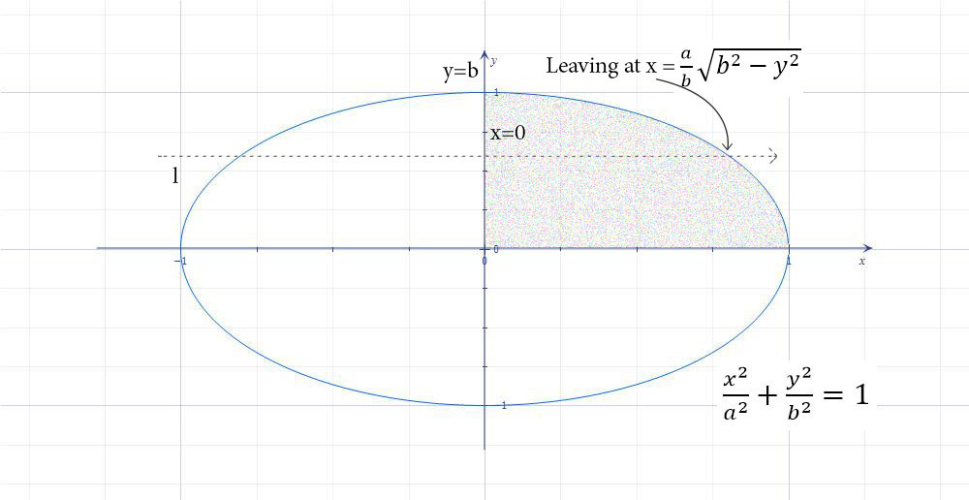
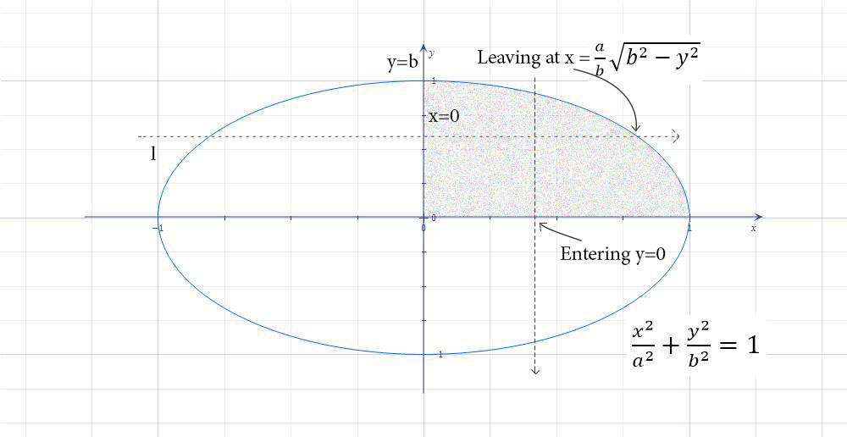
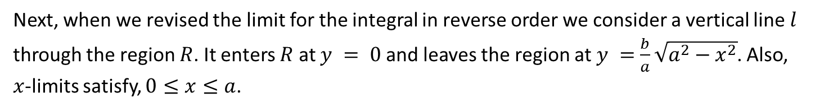
Next, when we revised the limit for the integral in reverse order we consider a vertical line $l$ through the region $R$. It enters $R$ at $y = 0$and leaves the region at $y =$ $\frac{b}{a}\sqrt{a^{2}−x^{2}}$. Also, $x$-limits satisfy, $0≤x≤a$.

Slide 14
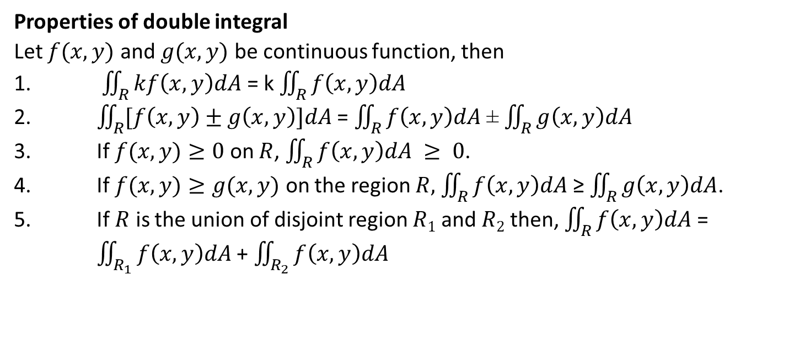
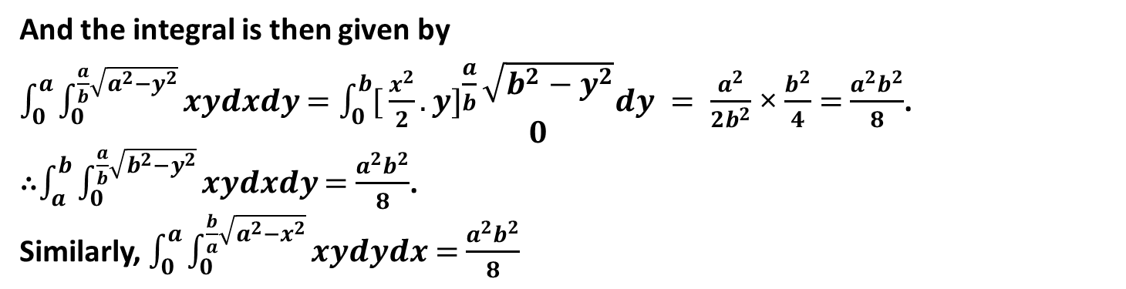
And the integral is then given by
$\int_{0}^{a}{\int_{0}^{\frac{a}{b}\sqrt{a^{2}−y^{2}}}{xydxdy}}$ $=\int_{0}^{b}{[}\frac{x^{2}}{2}.y]\begin{matrix}\frac{a}{b}\sqrt{b^{2}−y^{2}} \\ 0\end{matrix}dy = \frac{a^{2}}{2b^{2}}$ × $\frac{b^{2}}{4}$ $=$ $\frac{a^{2}b^{2}}{8}$.
∴$\int_{a}^{b}{\int_{0}^{\frac{a}{b}\sqrt{b^{2}−y^{2}}}{xydxdy}}$ $=$ $\frac{a^{2}b^{2}}{8}$.
Similarly, $\int_{0}^{a}{\int_{0}^{\frac{b}{a}\sqrt{a^{2}−x^{2}}}{xydydx}}$ $=$ $\frac{a^{2}b^{2}}{8}$
Properties of double integral
Let $f(x,y)$ and $g(x,y)$ be continuous function, then
1. $\iint_{R}{kf\left(x,y\right)dA}$ = k $\iint_{R}{f\left(x,y\right)dA}$
2. $\iint_{R}{[f\left(x,y\right)±g\left(x,y\right)]dA}$ = $\iint_{R}{f\left(x,y\right)dA}$ ± $\iint_{R}{g\left(x,y\right)dA}$
3. If $f(x,y)≥0$ on $R$, $\iint_{R}{f\left(x,y\right)dA} ≥ 0$.
4. If $f(x,y)≥g(x,y)$ on the region $R,$ $\iint_{R}{f\left(x,y\right)dA}$ ≥ $\iint_{R}{g\left(x,y\right)dA}$.
5. If $R$ is the union of disjoint region $R1$ and $R2$ then, $\iint_{R}{f\left(x,y\right)dA}$ = $\iint_{R_{1}}{f\left(x,y\right)dA}$ + $\iint_{R_{2}}{f\left(x,y\right)dA}$

Slide 15
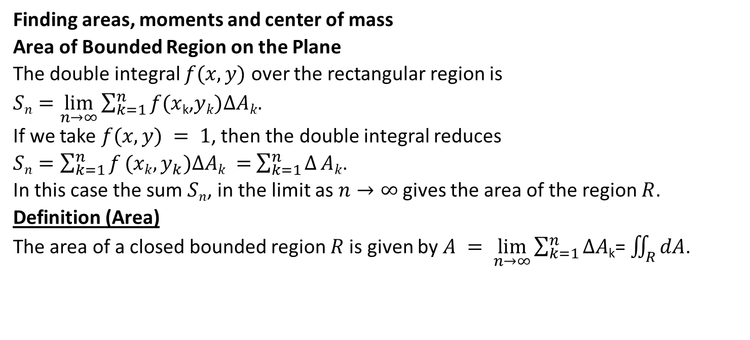
Finding areas, moments and center of mass
Area of Bounded Region on the Plane
The double integral $f(x,y)$ over the rectangular region is $Sn=\lim_{n→∞}{\sum_{k=1}^{n}{f(x}}$_{k},$yk)ΔAk$.
If we take $f(x,y) = 1$, then the double integral reduces $Sn=\sum_{k=1}^{n}{f}(xk,y_{k})ΔAk =$ $\sum_{k=1}^{n}{Δ}Ak$.
In this case the sum $Sn$, in the limit as $n→∞$gives the area of the region $R$.
Definition (Area)
The area of a closed bounded region $R$is given by $A = \lim_{n→∞}{\sum_{k=1}^{n}{ΔA}}$_{k}= $\iint_{R}{dA}$.

Slide 16
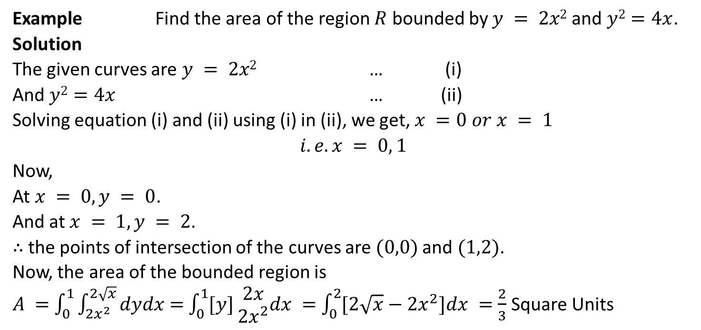
Example Find the area of the region $R$ bounded by $y = 2x2$and $y2=4x$.
Solution
The given curves are $y = 2x2$ … (i)
And $y2=4x$ … (ii)
Solving equation (i) and (ii) using (i) in (ii), we get, $x =0$ $or x = 1$
$$i.e. x = 0, 1$$
Now,
At $x = 0, y = 0$.
And at $x = 1, y = 2$.
∴ the points of intersection of the curves are $(0,0)$and $(1,2)$.
Now, the area of the bounded region is
$A =$ $\int_{0}^{1}{\int_{{2x}^{2}}^{2\sqrt{x}}{dydx}}$ $=$ $\int_{0}^{1}{[y]}\begin{matrix}2x \\ 2x^{2}\end{matrix}dx =$ $\int_{0}^{2}{[2\sqrt{x}}−2x^{2}]dx =$ $\frac{2}{3}$ Square Units

Slide 17
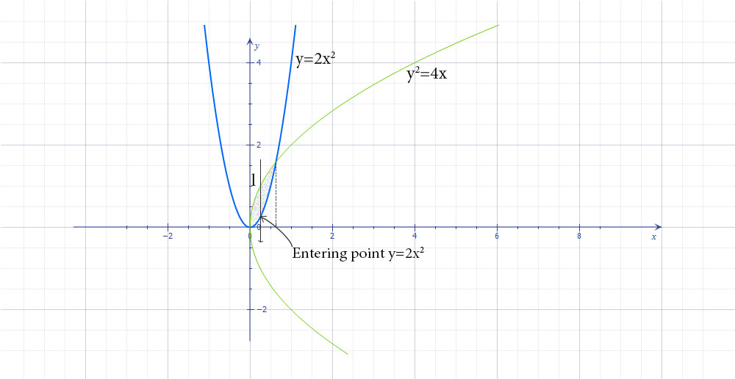

Slide 18
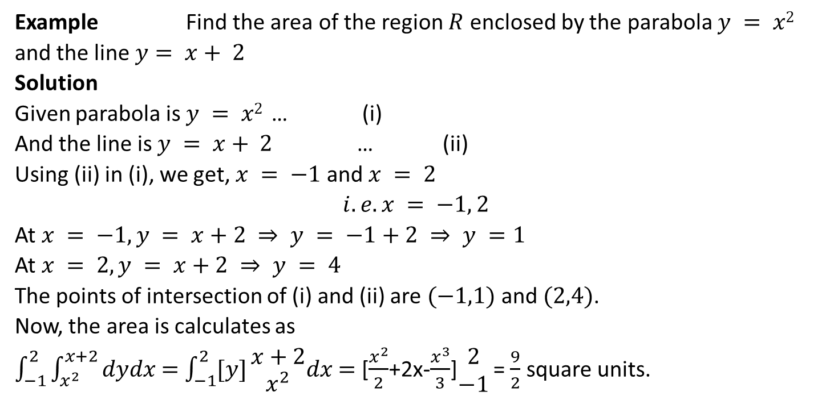
Example Find the area of the region $R$ enclosed by the parabola $y = x2$ and the line $y= x+ 2$
Solution
Given parabola is $y = x2$ … (i)
And the line is $y = x+ 2$ … (ii)
Using (ii) in (i), we get, $x = −1$and $x = 2$
$$i.e. x = −1, 2$$
At $x = −1, y = x+2 ⇒ y = −1+2 ⇒ y =1$
At $x = 2, y = x+2 ⇒ y = 4$
The points of intersection of (i) and (ii) are $(−1,1)$ and $(2,4)$.
Now, the area is calculates as
$\int_{−1}^{2}{\int_{x^{2}}^{x+2}{dydx}}$ $=$ $\int_{−1}^{2}{[y]}\begin{matrix}x+2 \\ x^{2}\end{matrix}dx$ $=$ [$\frac{x^{2}}{2}$+2x-$\frac{x^{3}}{3}$]$\begin{matrix}2 \\ −1\end{matrix}$ = $\frac{9}{2}$ square units.

Slide 19
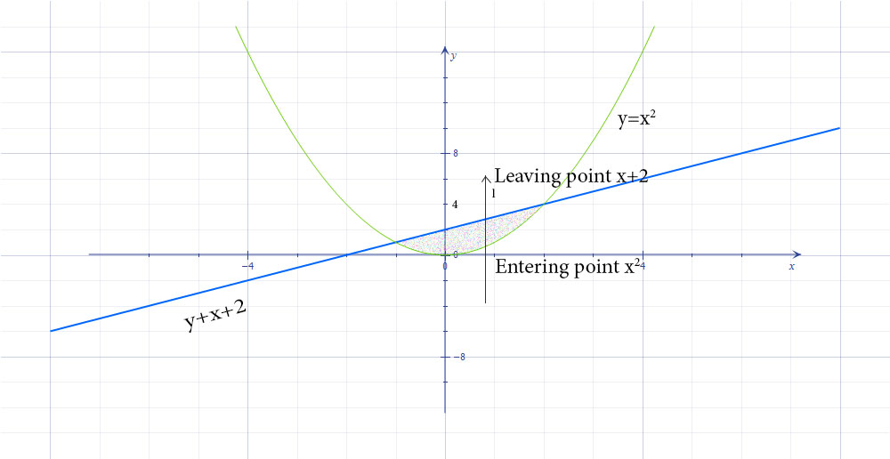

Slide 20
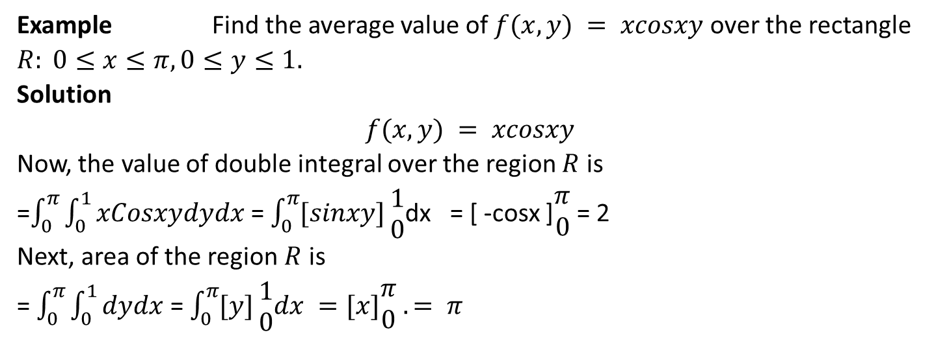
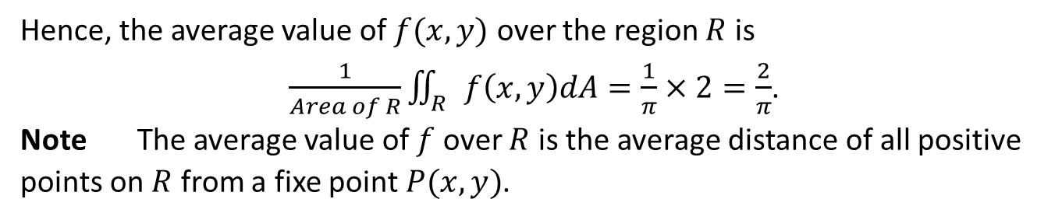
Average value of the function
The average value of $f(x,y)$ over the region $R$ is equal to
Example Find the average value of $f(x,y) = xcosxy$over the rectangle $R: 0≤x≤π, 0≤y≤1.$
Solution
$$f(x,y) = xcosxy$$
Now, the value of double integral over the region $R$ is
=$\int_{0}^{π}{\int_{0}^{1}{xCosxydydx}}$ = $\int_{0}^{π}{[sinxy]}\begin{matrix}1 \\ 0\end{matrix}$dx = [ -cosx ]$\begin{matrix}π \\ 0\end{matrix}$ = 2
Next, area of the region $R$ is
= $\int_{0}^{π}{\int_{0}^{1}{dydx}}$ = $\int_{0}^{π}{[y]}\begin{matrix}1 \\ 0\end{matrix}dx =[x]\begin{matrix}π \\ 0\end{matrix}$ $.= π$
Hence, the average value of $f(x,y)$ over the region $R$ is
$\frac{1}{Area of R}\iint_{R}{f\left(x,y\right)dA}=\frac{1}{π}×2=\frac{2}{π}$.
Note The average value of $f$ over $R$ is the average distance of all positive points on $R$ from a fixe point $P(x,y)$.

Slide 21
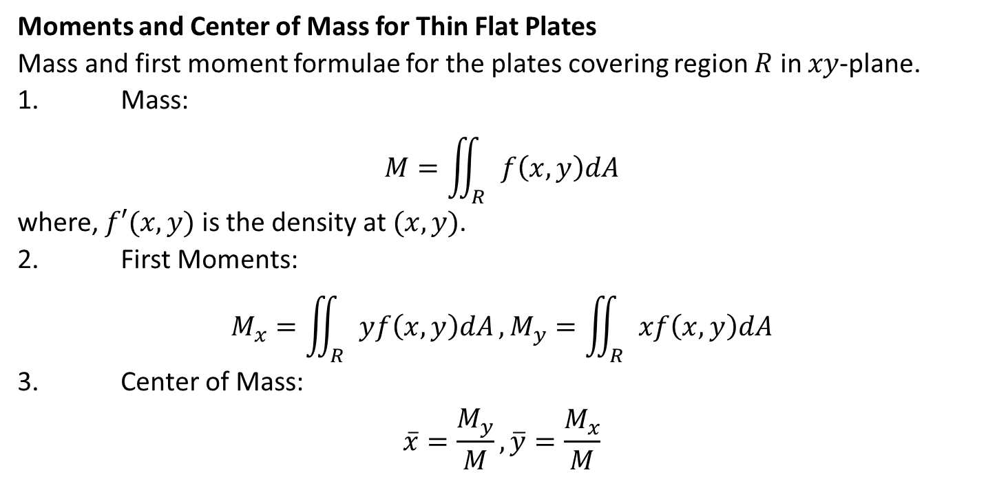
Moments and Center of Mass for Thin Flat Plates
Mass and first moment formulae for the plates covering region $R$ in $xy$-plane.
1. Mass:
$$M=\iint_{R}{f\left(x,y\right)dA}$$
where, $f′(x,y)$ is the density at $(x,y)$.
2. First Moments:
$$M_{x}=\iint_{R}{yf\left(x,y\right)dA},M_{y}=\iint_{R}{xf\left(x,y\right)dA}$$
3. Center of Mass:
$$\overline{x}=\frac{M_{y}}{M},\overline{y}=\frac{M_{x}}{M}$$

Slide 22
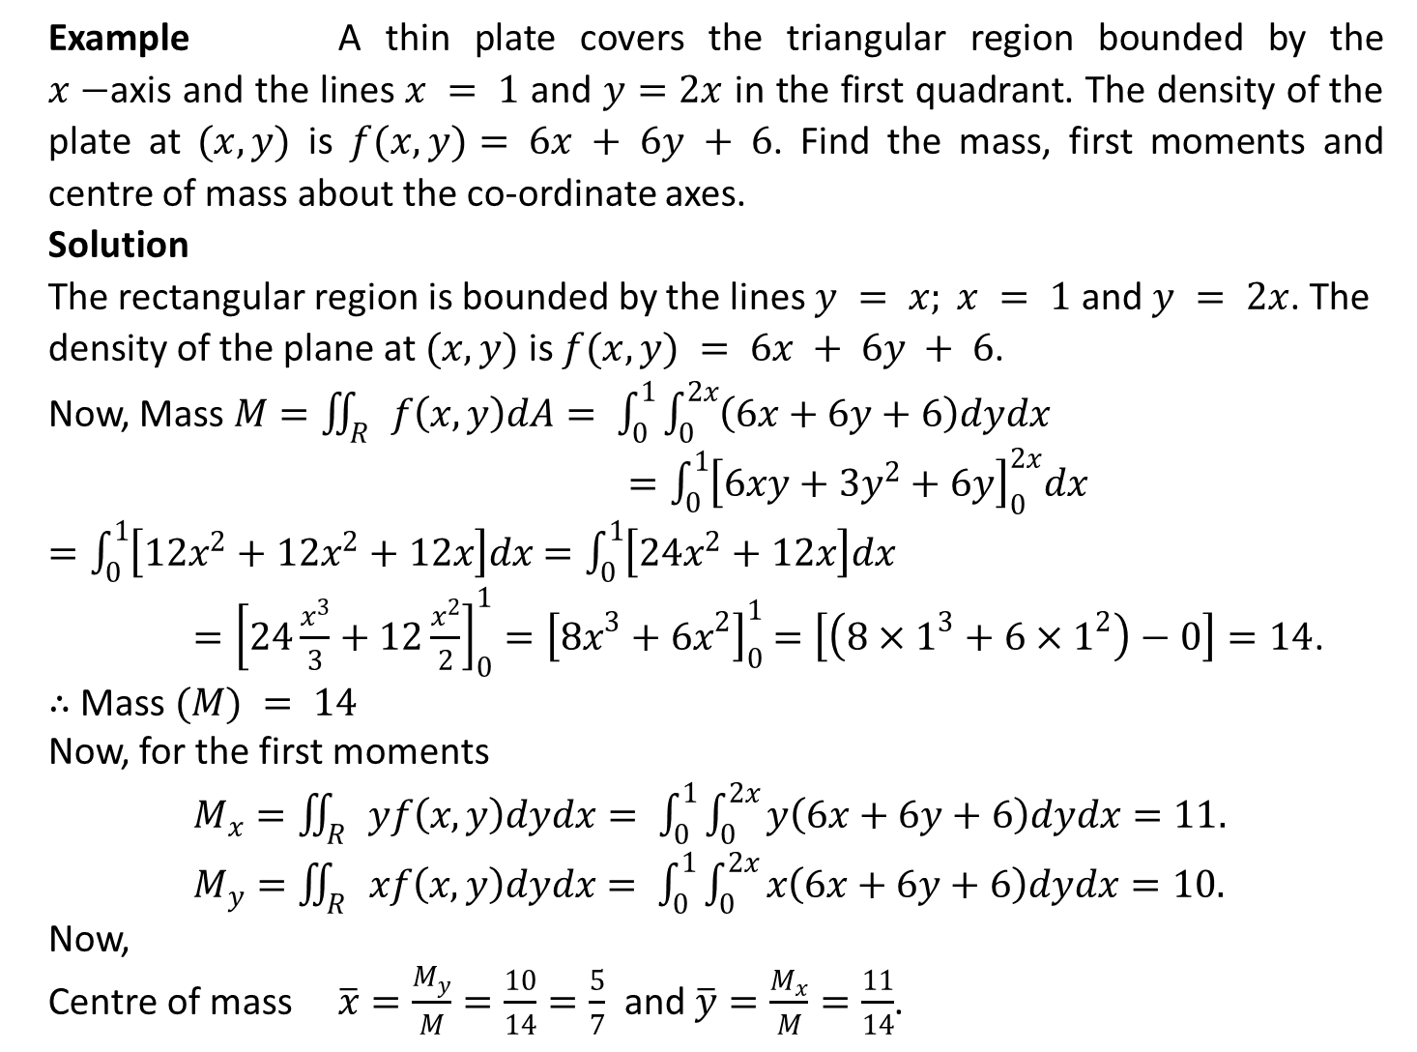
Example A thin plate covers the triangular region bounded by the $x−$axis and the lines $x = 1$ and $y=2x$ in the first quadrant. The density of the plate at $(x,y)$ is $f(x,y)= 6x + 6y + 6$. Find the mass, first moments and centre of mass about the co-ordinate axes.
Solution
The rectangular region is bounded by the lines $y = x; x = 1$ and $y = 2x$. The density of the plane at $(x,y)$ is $f(x,y) = 6x + 6y + 6$.
Now, Mass $M=\iint_{R}{f\left(x,y\right)dA= \int_{0}^{1}{\int_{0}^{2x}{\left(6x+6y+6\right)dydx}}}$
$=\int_{0}^{1}{{\left[6xy+3y^{2}+6y\right]}_{0}^{2x}dx}$
$=\int_{0}^{1}{\left[12x^{2}+12x^{2}+12x\right]dx}$ $=\int_{0}^{1}{\left[24x^{2}+12x\right]dx}$ $={\left[24\frac{x^{3}}{3}+12\frac{x^{2}}{2}\right]}_{0}^{1}={\left[{8x}^{3}+{6x}^{2}\right]}_{0}^{1}$ $=\left[\left(8×1^{3}+6×1^{2}\right)−0\right]=14$.
∴ Mass $(M) = 14$
Now, for the first moments
$M_{x}=\iint_{R}{yf\left(x,y\right)dydx= \int_{0}^{1}{\int_{0}^{2x}{y\left(6x+6y+6\right)dydx=11.}}}$
$M_{y}=\iint_{R}{xf\left(x,y\right)dydx= \int_{0}^{1}{\int_{0}^{2x}{x\left(6x+6y+6\right)dydx=10.}}}$
Now,
Centre of mass $\overline{x}=\frac{M_{y}}{M}=\frac{10}{14}=\frac{5}{7}$ and $\overline{y}=\frac{M_{x}}{M}=\frac{11}{14}$.

Slide 23
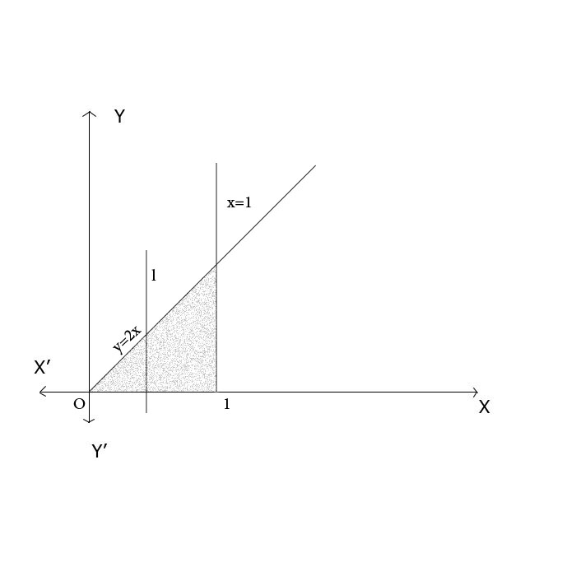

Slide 24
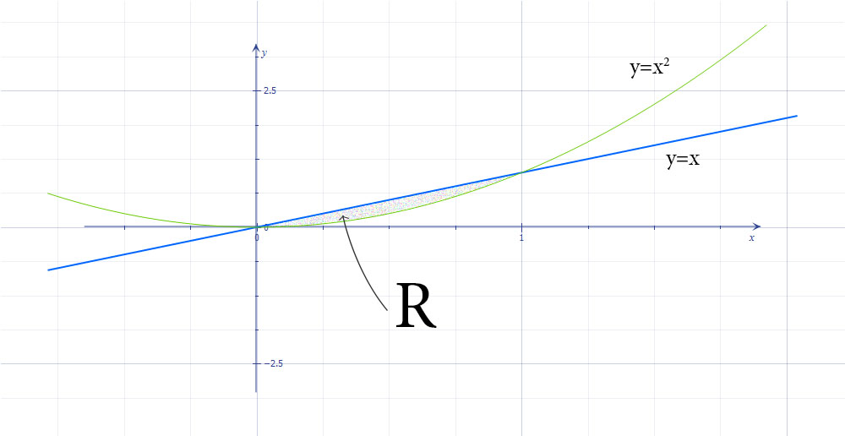
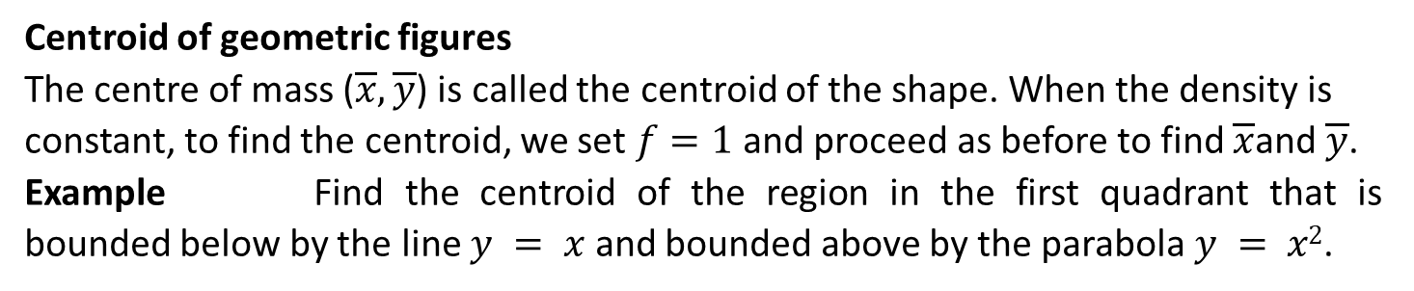
Centroid of geometric figures
The centre of mass ($\overline{x},\overline{y}$) is called the centroid of the shape. When the density is constant, to find the centroid, we set $f=1$ and proceed as before to find $\overline{x}$and $\overline{y}$.
Example Find the centroid of the region in the first quadrant that is bounded below by the line $y = x$ and bounded above by the parabola $y = x2$.

Slide 25
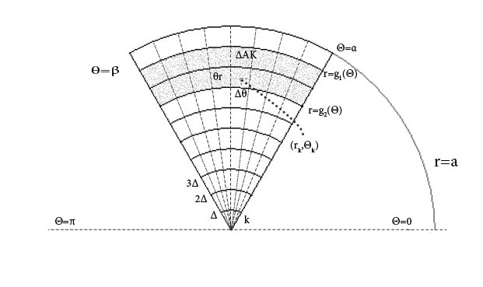
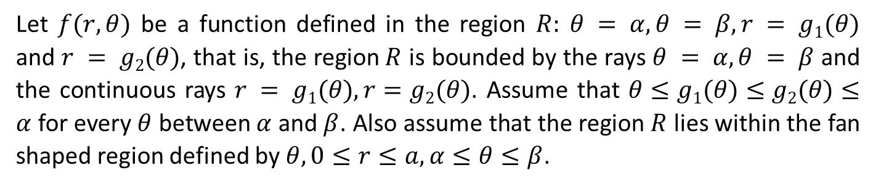
Double integral in polar form
Let $f(r,θ)$ be a function defined in the region $R: θ = α, θ = β, r = g1(θ)$ and $r = g2(θ)$, that is, the region$R$ is bounded by the rays $θ = α, θ = β$ and the continuous rays $r = g1(θ), r=g2(θ)$. Assume that $θ≤g1(θ)≤g2(θ)≤α$ for every $θ$ between $α$ and $β$. Also assume that the region $R$ lies within the fan shaped region defined by $θ, 0≤r≤a, α≤θ≤β$.

Slide 26
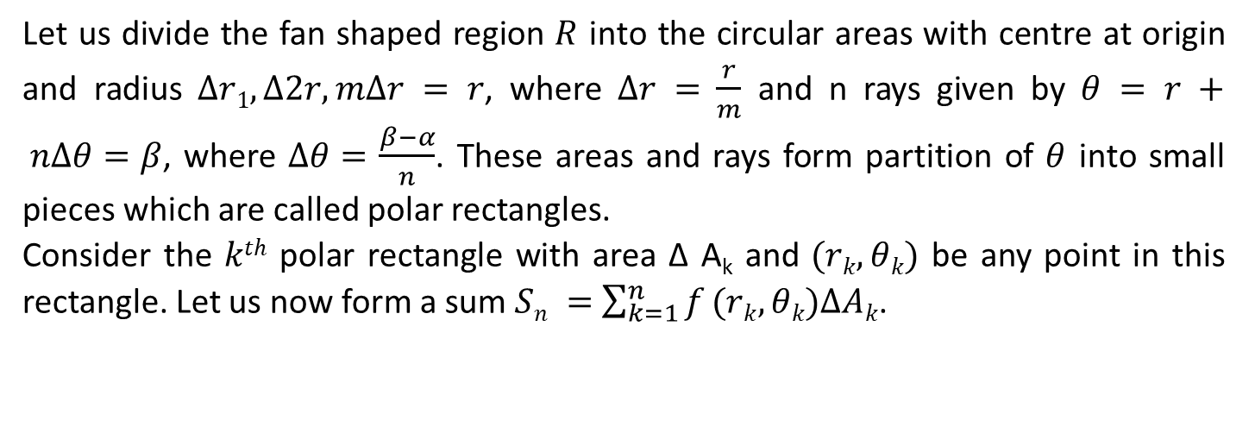
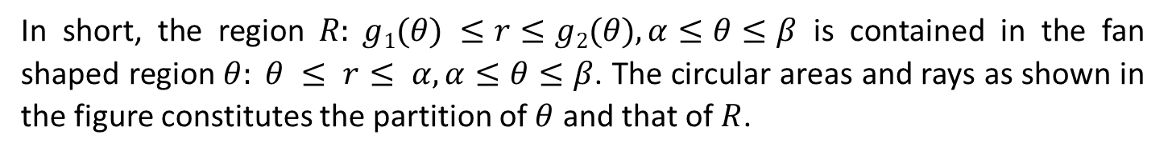
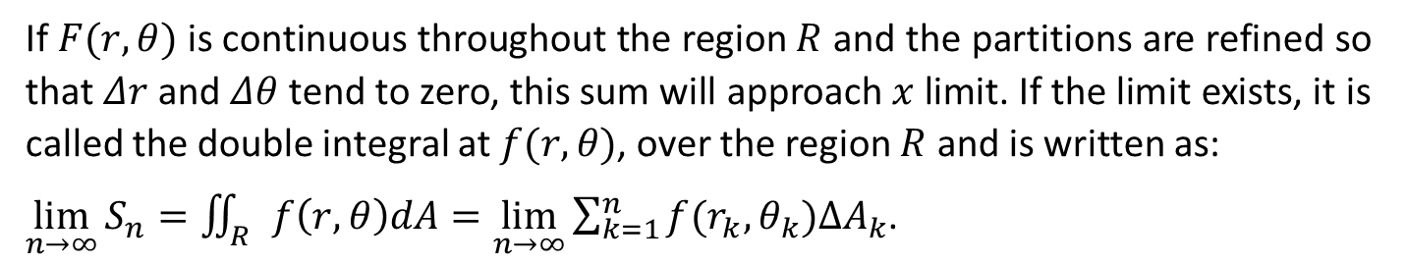
In short, the region $R: g1(θ) ≤r≤g2(θ), α≤θ≤β$ is contained in the fan shaped region $θ: θ ≤ r≤ α, α≤θ≤β$. The circular areas and rays as shown in the figure constitutes the partition of $θ$ and that of $R$.
Let us divide the fan shaped region $R$ into the circular areas with centre at origin and radius $Δr1, Δ2r, mΔr = r$, where $Δr =$ $\frac{r}{m}$ and n rays given by $θ = r + nΔθ=β$, where $Δθ=$ $\frac{β−α}{n}$. These areas and rays form partition of $θ$ into small pieces which are called polar rectangles.
Consider the $kth$ polar rectangle with area Δ A_{k} and $(rk,θk)$ be any point in this rectangle. Let us now form a sum $Sn =$ $\sum_{k=1}^{n}{f}(rk,θk)ΔAk$.
If $F(r,θ)$ is continuous throughout the region $R$ and the partitions are refined so that $Δr$ and $Δθ$ tend to zero, this sum will approach $x$ limit. If the limit exists, it is called the double integral at $f(r,θ)$, over the region $R$ and is written as:
$\lim_{n→∞}{S_{n}=\iint_{R}{f\left(r,θ\right)dA=\lim_{n→∞}{\sum_{k=1}^{n}{f(r_{k},θ_{k})∆A_{k}}}}}$.

Slide 27
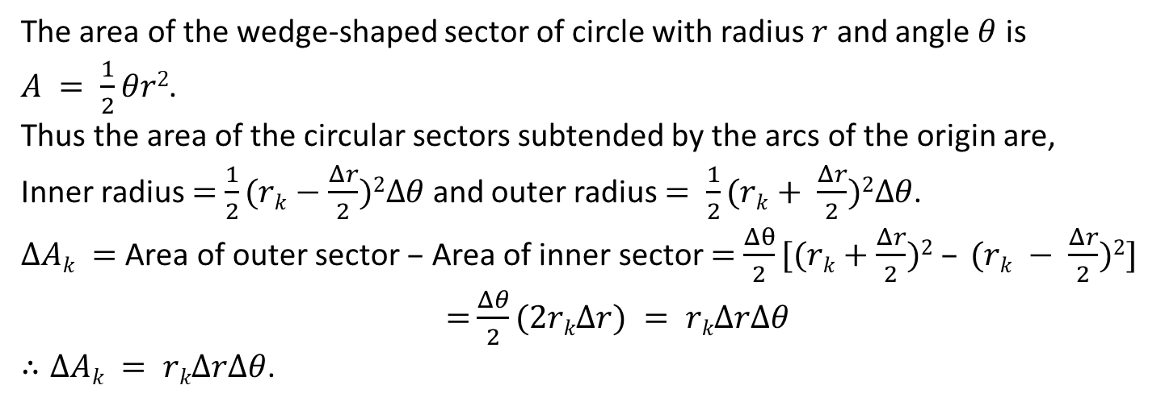
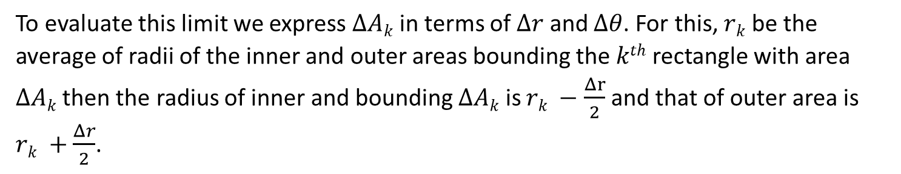
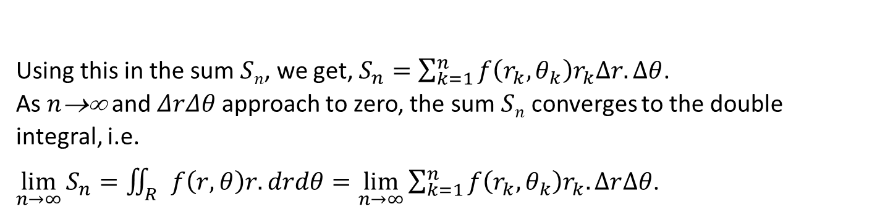
To evaluate this limit we express $ΔAk$ in terms of $Δr$ and $Δθ$. For this, $rk$ be the average of radii of the inner and outer areas bounding the $kth$ rectangle with area $ΔAk$ then the radius of inner and bounding $ΔAk$ is $rk −$ $\frac{Δr}{2}$ and that of outer area is $rk +$ $\frac{Δr}{2}$.
The area of the wedge-shaped sector of circle with radius $r$ and angle $θ$ is $A = \frac{1}{2}θr2$.
Thus the area of the circular sectors subtended by the arcs of the origin are,
Inner radius $=$ $\frac{1}{2}(rk−$ $\frac{Δr}{2})2Δθ$ and outer radius $= \frac{1}{2}(rk+ \frac{Δr}{2})2Δθ$.
$ΔAk =$ Area of outer sector $–$ Area of inner sector $=$ $\frac{Δθ}{2}[(rk+$ $\frac{Δr}{2})2 – (rk − \frac{Δr}{2})2]$
$=$ $\frac{Δθ}{2}(2rkΔr) = rkΔrΔθ$
$∴ΔAk = rkΔrΔθ$.
Using this in the sum $Sn$, we get, $S_{n}=\sum_{k=1}^{n}{f\left(r_{k},θ_{k}\right)r_{k}∆r.∆θ}$.
As $n$→∞ and $ΔrΔθ$ approach to zero, the sum $Sn$ converges to the double integral, i.e.
$\lim_{n→∞}{S_{n}=\iint_{R}{f\left(r,θ\right)r.drdθ=\lim_{n→∞}{\sum_{k=1}^{n}{f\left(r_{k},θ_{k}\right)r_{k}.∆r∆θ}}}}$.

Slide 28
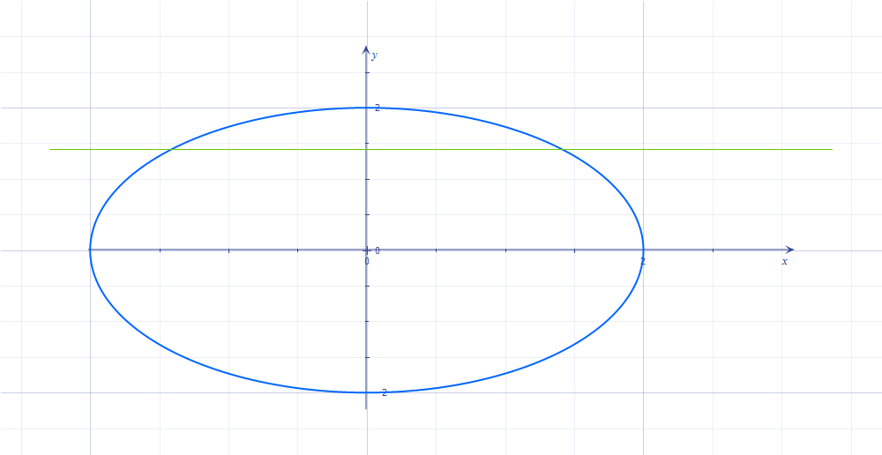

Fubini's Theorem
$\iint_{R}{f\left(r,θ\right)dA=\int_{θ=α}^{θ=β}{\int_{r=g_{1}(θ)}^{r=g_{2}(θ)}{f\left(r,θ\right)rdrdθ}}}$.
Finding limits of integration
1. Sketch
Sketch the region of integral and label the bounding curves.

Slide 29



2. Finding $r$-limits
Draw an imaginary ray $l$ through the origin in the direction of $r$ increasing. And mark the points where $l$ enters and leaves the region $R$. These points give the $r$ limits of integration depending on the value of angle θ.
3. Finding $θ$ limits
Finding the smallest and largest values of $θ$ that bounds the region $R$. Then the double integral is
$\iint_{R}{f\left(r,θ\right)dA=\int_{\frac{π}{4}}^{\frac{π}{2}}{\int_{\sqrt{2}cosecθ}^{2}{f\left(r,θ\right)rdrdθ}}}$.

Slide 30


Example Find the limits of integration for integrating $f(r1,θ)$ over the region $R$ that lies inside the centroid $r = 1+cosθ$and outside the circle $r = 1$.
Solution
Graph the given functions are:

Slide 31


$r = 1 + cosθ$ … (i)
and $r = 1$ … (ii)
and level the bounding curves as above the ray $l$ enters the region $R$ at $r = 1$ and leaves at $r = 1 + cosθ$.
So the $r$-limit lies between $r=1$ and $r = 1 +cosθ$.
Also, the θ limit changes from $−\frac{π}{2}$ to $\frac{π}{2}$.
The double integral is $\int_{−\frac{π}{2}}^{\frac{π}{2}}{\int_{1}^{1+Cosθ}{f\left(r,θ\right)}}$
Area in Polar Co-ordinates
If the function $f(r,θ)$ is constant function with $f(r,θ) = 1$, then the double integral of $f(r,θ)$ over the region gives the area of the region $R$. That is, the area of the closed and bounded region $R$ in the polar co-ordinate is
$A =$ $\iint_{R}{rdrθ}$.

Slide 32


Example Find the area enclosed by the centroid $r = a(1+cosθ)$
Solution
The given curve is the cardioid $r = a(1+cosθ)$. Its graph is shown as

Slide 33

First, we evaluate the area of the shaded region and then multiply it by $2$ to get the total area.
The $r$-limit changes from $r = 0$ to $r = 1(1+cosθ)$ and the $θ$ limit changes from $0$ to $π$. The area of the shaded region is:
$A1 =$ $\iint_{R}{rdrdθ}$ $=$ $\int_{0}^{π}{\int_{0}^{a(1+cosθ)}{rdrdθ}}$
=$\int_{0}^{π}{[\frac{r^{2}}{2}}]\begin{matrix}a(1+cosθ) \\ 0\end{matrix}dθ$
=$\int_{0}^{θ}{\frac{{a^{2}(1+cosθ)}^{2}}{2}}dθ$
=$\frac{a^{2}}{2}\int_{0}^{π}{{{(2cos}^{2}\frac{θ}{2})}^{2}dθ}$
= $\frac{2a^{2}}{2}\int_{0}^{π}{\cos^{4}\frac{θ}{2}dθ}$
Put $\frac{θ}{2}$ $= t$. Then, $dθ = 2dt$.
At $θ = 0  t = 0$and $θ = π  t =$ $\frac{π}{2}$
Then, $A1=2a2\int_{0}^{\frac{π }{2}}{\cos^{4}t(3dt)}=$ $\frac{3πa^{2}}{4}$
$∴ A1 =$ $\frac{3πa^{2}}{4}$
Hence, total area $A = 2 × A1 =$ $\frac{3πa^{2}}{2}$.

Slide 34

Reduction Formula
1. $\int_{0}^{\frac{π}{2}}{\sin^{n}xdx}$ = $\frac{\left(n−1\right)\left(n−3\right)\left(n−5\right)…1}{n\left(n−2\right)\left(n−4\right)….2}$ × $\frac{π}{2}$ if $n$ is even
=$\frac{\left(n−1\right)\left(n−3\right)\left(n−5\right)…2}{n\left(n−2\right)\left(n−4\right)…3}$ if $n$ is odd
2. $\int_{0}^{\frac{π}{2}}{\cos^{n}xdx}$ = $\frac{\left(n−1\right)\left(n−3\right)\left(n−5\right)…2}{n\left(n−2\right)\left(n−4\right)….3}$ if $n$ is odd
= $\frac{\left(n−1\right)\left(n−2\right)\left(n−5\right)…1}{n\left(n−2\right)\left(n−4\right)….2}$ × $\frac{π}{2}$ if $n$ is even

Slide 35

Triple Integral in Cartesian Co-ordinate
Let $f(x,y,z)$ be a function defined in a closed bounded region $D$ in the space. Then the triple integration of $F$ over $D$ is defined as follows:
We divide (partition) the rectangular box shaped region into small rectangular (parallelepiped) cells by drawing planes parallel to the co-ordinate axes. Let the $kth$ rectangular "parallelepiped" cell has dimensions $Δxk, Δyk and Δzk$. So its volume $ΔVk=Δxk.Δyk.Δzk.$
Let $(xk,yk,zk)$ be any point on the k^{th} cell. We now form a sum $Sn= F(xk,yk,zk)ΔVk$.
We now define the partition of the region D so that $Δxk, Δyk, ΔZk$, the normal of the partition $||P||$ approach zero. If the limit of the sum $Sn$ in this case exists, i.e.$\lim_{n→∞}{S}$_{n} exists, we say that $F(x,y,z)$ is integrable over the region $D$. And if this limit exists as $||P|| → 0$ as $n→∞$, this limit is said to be triple integral of $f(x,y,z)$ over $D$ and we write as
$\lim_{n→∞}{S}$_{n}­=$\iiint_{D}{F\left(x,y,z\right)dv}$ = $\iiint_{D}{F\left(x,y,z\right)dxdydz}$

Slide 36


Volume of a region in space
If $F(x,y,z)$ is a constant function with value 1, then the triple integral of F gives the volume of the closed bounded region $D$ in space and is given by
V = $\iiint_{D}{dv}$= $\iiint_{D}{dxdydz}$.
Mass and moments in three dimensions
1. Mass
$\iiint_{D}{fdx}$, where f(x,y,z) is the density.
2. First moment about the co-ordinate plane
M_{yz} = $\iiint_{D}{xfdv},$ M_{zx} = $\iiint_{D}{yfdv}$ and M_{xy}= $\iiint_{D}{zfdv}$
3. Centre of mass
$\overline{x}$ = $\frac{M_{yz}}{M}$, $\overline{y}$=$\frac{M_{zx}}{M}$, $\overline{z}=\frac{M_{xy}}{M}$
4. Moment of intertia (Second moment) about the co-ordinate axes
$Ix =$ $\iiint_{D}{(}y2+z2)fdv$, $Iy=\iiint_{D}{(}z2+x2)fdv$, $Iz=\iiint_{D}{(}x2+y2)fdv$
5. Moment of inertia about a line
$Il =$ $\iiint_{D}{r}2fdv$, where $f(x,y,z)$ is the distance of any point $(x,y,z)$from the line $L$.
6. Radius of gyration about a line $l:$ $Rl =$ $\sqrt{I\frac{l}{M}}$

Slide 37

Triple Integral in Cylindrical Co-ordinates

Slide 38

Let $P$ be any point in the space. Draw $PQ$ perpendicular to $xy$-plane, join $OQ$. Draw $QA$ perpendicular to $x$-axis and $QB$ perpendicular to $y$-axis.
Let $OQ = r$and $∠AOQ = θ$and $PQ = z$. Then the cylindrical co-ordinates of the points $P$ are represented by the ordered triple $P(r,θ,z)$.
Relation of the Cartesian and cylindrical co-ordinates
$$x = rcosθ; y = rsinθ; z = z$$
$$r2 = x2+y2, tanθ = \frac{y}{x}$$

Slide 39

Triple Integral in Spherical Co-ordinates
P

Slide 40

Let $P$ be any point in the space, draw $PQ$ perpendicular to the $xy$-plane, draw $QA$ perpendicular to $x$-axis, $QB$ perpendicular to $y$-axis and join $OP$ and $OQ$.
Let $OQ = r, ∠AOQ = θ$, $OP = $ and $∠POZ = φ$. Therefore, from the figure $z =cosφ$. Then, the ordered triples $(, φ, θ)$ is called the spherical co-ordinates of the point $P$.
Relation of Cartesian co-ordinates to spherical co-ordinates and cylindrical co-ordinates.
$$r = sinφ; x = rcosθ = sinφcosθ; y = rsinθ = sinφcosθ; z = cosφ$$
$$ =$\sqrt{x^{2}+y^{2}+z^{2}}$ = $\sqrt{r^{2}+z^{2}}$.

Slide 41

Example Find a spherical co-ordinate equation for the sphere
$x2+(y−1)2 + z2 = 1$.
Solution
The given equation is $x2+(y−1)2+z2 = 1$ … (i)
We know, in spherical co-ordinates
$$r = Sinφ; x = sinφcosθ; y = sinφcosθ; z = cosφ$$
$$ =$\sqrt{x^{2}+y^{2}+z^{2}}$ = $\sqrt{r^{2}+z^{2}}$
Now,, substituting this value in equation (i), we get
$$2sin2φcos2θ + (sinφsinθ−1)2 + 2cos2φ = 1$$
Or, $2sin2φ cos2θ + 2sin2φsin2θ – 2 sinφsinθ + 1 + 2cos2φ = 1$
Or, $2(sin2φcos2θ+sin2φsin2θ) − 2sinφsinθ + 2cos2φ = 0$
Or, $2 − 2sinφsinθ = 0$

Slide 42
The End

